Slide 1
2007-2011 American Community Survey (ACS) County-to-County Migration Flows Products

Slide 2
The U.S. Census Bureau is releasing new data and tools that allow users to examine migration patterns of people.
Products consist of two main components:
County-to-County Migration Flows Package
Excel and text tables – includes additional estimates and margins of error (MOE) for analysis
Census Flows Mapper
Users can look at migration patterns at national and regional scales across many different population characteristics for counties of interest
Tutorial illustrates how to use inbound, outbound, and net migration for analysis

Slide 3
County-to-County Migration Flows
Contents and Guide to Calculating Rates

Slide 4
Let’s first take a look at the County-to-County Flows tables

Slide 5
The County-to-County tables contain:
FIPS Codes for both origination and destination counties
Code for breakdown of characteristics (values are listed in table footnotes)
Name of the destination county (current residence)
Summary statistics and MOE for the destination county
Notes:
Note that individual income is the income a person makes the previous 12 months to when they are surveyed. It does not show income strictly before or after the move.

Slide 6
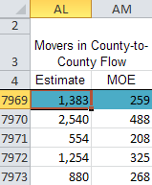
The County-to-County tables contain:
Name of the origin county (previous residence)
Summary statistics and MOE for the origin county (previous residence)
The estimate and MOE for the flow from the origination county to the destination county

Slide 7
Individual income and educational attainment for county flows are published in American Factfinder.
(www.factfinder2.census.gov)

Slide 8
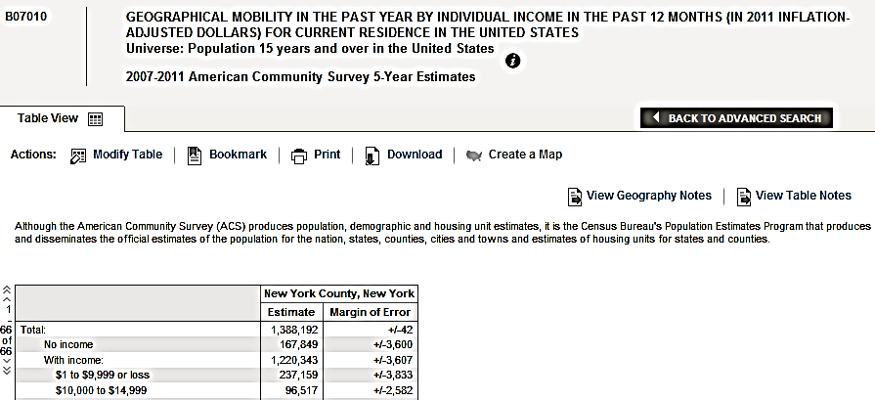
There are detailed tables based on destination county (current residence)

Slide 9
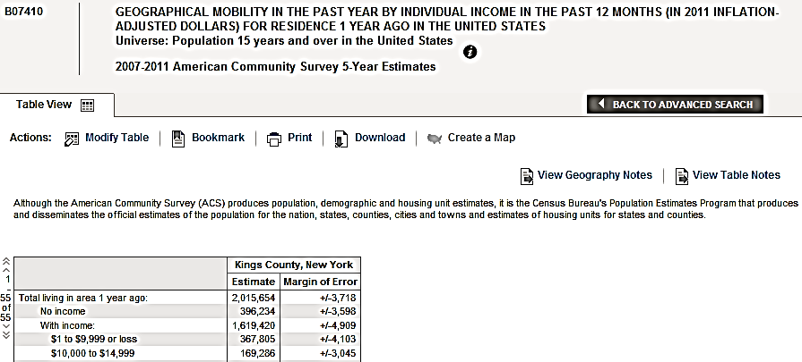
…and ones based on origination county (previous residence) .
Only County-to-County Flows tables connect origin and destination.

Slide 10
Household income crossed by migration and the summary statistics are unique to this product and are not available on American FactFinder.

Slide 11
Using the supplemental statistics, in- and out- migration rates can be calculated.
Intercounty Migration Rates for Counties in New York City by Selected Individual Income Levels
 | $1 to $9,999 or loss |  | $75,000 or more
 | Inbound | Outbound | Inbound | Outbound
Bronx County, NY | 4.8 | 5.3 | 3.0 | 5.0
Kings County, NY | 3.3 | 6.5 | 4.0 | 5.3
New York County, NY | 10.0 | 8.0 | 5.5 | 5.6
Queens County, NY | 3.4 | 5.1 | 2.6 | 4.9
Richmond County, NY | 4.2 | 6.0 | 1.5 | 2.3
Source: U.S. Census Bureau, 2007-2011 American Community Survey
The table above shows that for ever 100 persons in Bronx County that have an individual income of $1 to $9,999 or loss, 4.8 of them moved from a different county and another 5.3 moved out of Bronx County.

Slide 12
Census Flows Mapper version 1.1 User Tutorial and Examples

Slide 13
Version 1.1 has 3 New Characteristics Based on the 2007-2011 5-yr ACS Data
Educational Attainment
Less than high school graduate
High school graduate
Some college
Bachelor’s degree
Graduate or professional degree
Personal Income
Less than $9,999 or loss
$10,000 - $14,999
$15,000 - $24,999
$25,000 - $34,999
$35,000 - $49,999
$50,000 - $64,999
$65,000 - $74,999
$75,000 or more
Household Income
Less than $10,000
$15,000 - $24,999
$25,000 - $34,999
$35,000 - $49,999
$50,000 - $99,999
$100,000 - $149,999
$150,000 or more

Slide 14
Tutorial Examples Using the 2007-2011 Characteristics
1. Educational Attainment
Category: Graduate and Professional Degrees Geography: Middlesex County, MA
2. Individual Income Category: $75,000 or more Geography: New York County, NY
3. Household Income Category: $150,000 or more Geography: Los Angeles County, CA

Slide 15
First, let’s look at Educational Attainment

Slide 16
Example: Middlesex County, MA A National View of net Migration Flows for those with Graduate or Professional Degrees into and out from Middlesex County, MA.

Slide 17
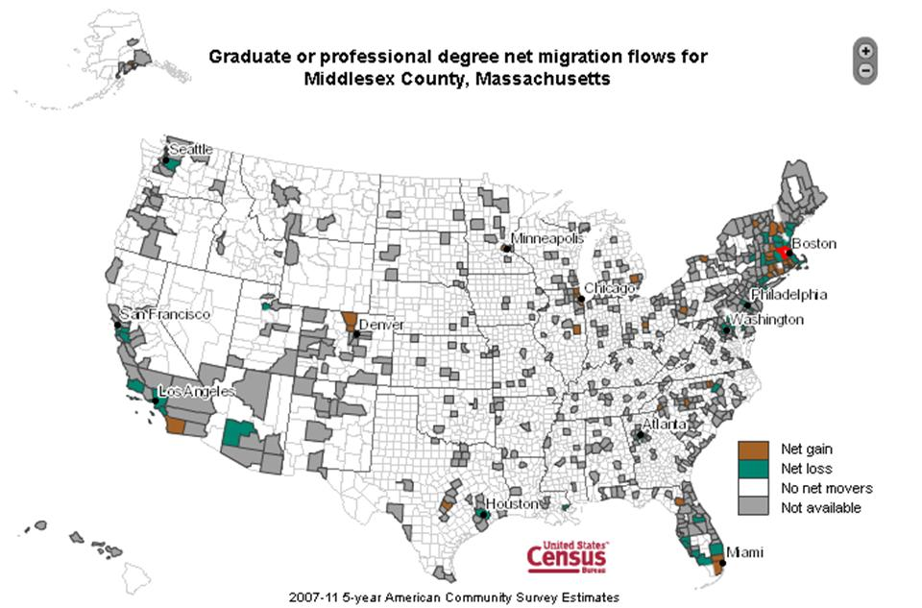

Slide 18
Among Largest Domestic Migration with Graduate or Professional Degrees (population 25 Years and Over)
Inbound
Outbound
Middlesex, Massachusetts | 13,767
From: Suffolk County, MA | 2,932
Norfolk County, MA | 1,241
Essex County, MA | 528
Worcester County, MA | 454
New York County, NY | 448
Middlesex, Massachusetts | 14,342
To: Suffolk County, MA | 1,812
Norfolk County, MA | 1,697
Essex County, MA | 799
Worcester County, MA | 712
New York County, NY | 605
Source: American FactFinder and County-to-County Table Package, 2007-2011 5-yr ACS
Migrants 25 years and over with graduate or professional degrees were moving into and out of Middlesex County, MA. Among the largest inflows were those from neighboring counties and New York County, NY. In fact, 21.3 percent of the inbound flow of people with graduate or professional degrees was from Suffolk County, MA.

Slide 19
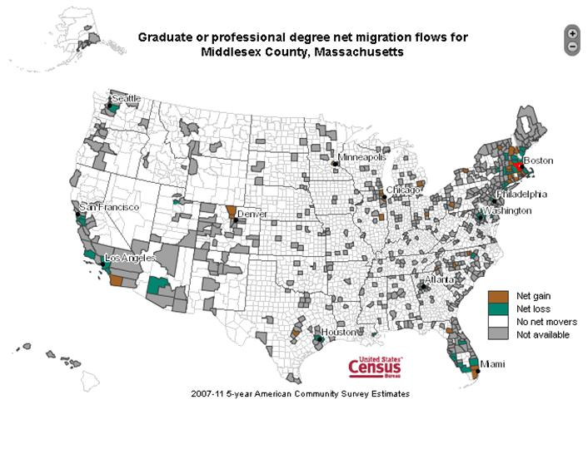
Why does my
map have so
much gray?
The ACS uses various
disclosure avoidance measures
for county-to-county migration
estimates.
Only information is displayed by the selected characteristic if at least 3 people in different households or individuals in group quarters in sample for the characteristic universe. Otherwise, the county is gray in the Flows Mapper.

Slide 20
Example: Middlesex County, MA A Regional View of Net Migration Flows for those with Graduate or Professional Degrees comparing Middlesex County, MA to Suffolk County, MA

Slide 21
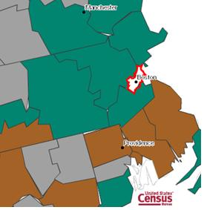
Educational Attainment: Graduate or Professional
Middlesex County, MA
County | Net Migrants
Essex County, MA | -271
Worcester County, MA | -258
Norfolk County, MA | -456
Suffolk County, MA | 1,120
Hillsborough County, NH | -217
Suffolk County, MA
County | Net Migrants
Essex County, MA | -246
Middlesex County, MA | -1,120
Norfolk County, MA | -299
Plymouth County, MA | 15
Bristol County, MA | 15

Slide 22
Next, let’s look at Individual Income

Slide 23
Example: New York County, NY A National View of net Migration Flows for those with Individual Income of $75,000 or More into and out from New York County, NY

Slide 24
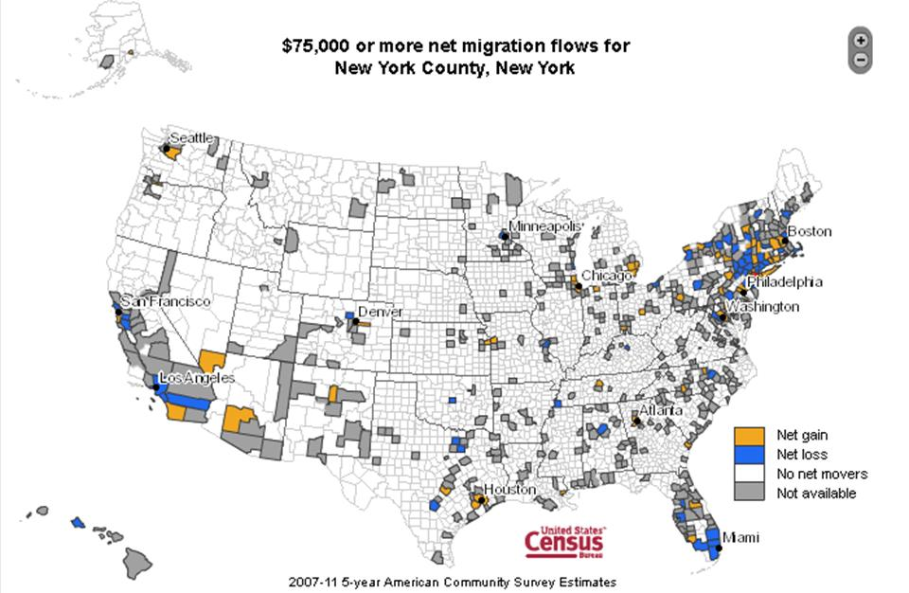

Slide 25
Among Largest Domestic Migration with Individual Income of $75,000 or More (population 15 Years and Over)
Inbound
Outbound
New York County, New York | 19,669
From: Kings County, NY | 2,036
Queens County, NY | 1,270
Hudson County, NJ | 1,265
Nassau County, NY | 948
Los Angeles County, CA | 875
New York County, New York | 19,830
To: Kings County, NY | 3,448
Hudson County, NJ | 1,764
Westchester County, NY | 1,340
Los Angeles County, CA | 1,043
Queens County, NY | 1,022
Migrants with incomes of $75,000 or more were moving out of New York County. Among the largest outflows, was Westchester County, New York (1,340 movers). Approximately 6.8 percent of all movers from New York County that have incomes greater than $75,000 moved to Westchester County.
The net flow for this group suggests that Kings County, NY is gaining more affluent individuals from New York County than it is losing. Movers from New York County to Kings County making $75,000 or more comprised 17 percent of the total outbound flow while only 10 percent of the inbound flow from Kings County to New York County.

Slide 26
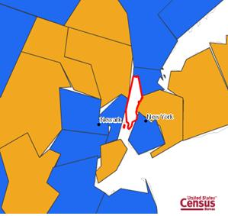
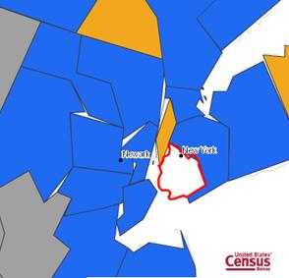
Individual Income: $75,000 or more
New York County, NY
County | Net Migrants
Bronx County, NY | -259
Queens County, NY | 248
Kings County, NY | -1,412
Richmond County, NY | 103
Hudson County, NJ | -499
Kings County, NY
County | Net Migrants
Bronx County, NY | -31
Queens County, NY | -389
New York County, NY | 1,412
Richmond County, NY | -505
Hudson County, NJ | -214

Slide 27
Last, let’s look at Household Income

Slide 28
Example: Los Angeles County, CA A National View of net Migration Flows for those with Household Income of $150,000 or More into and out from Los Angeles County, CA

Slide 29
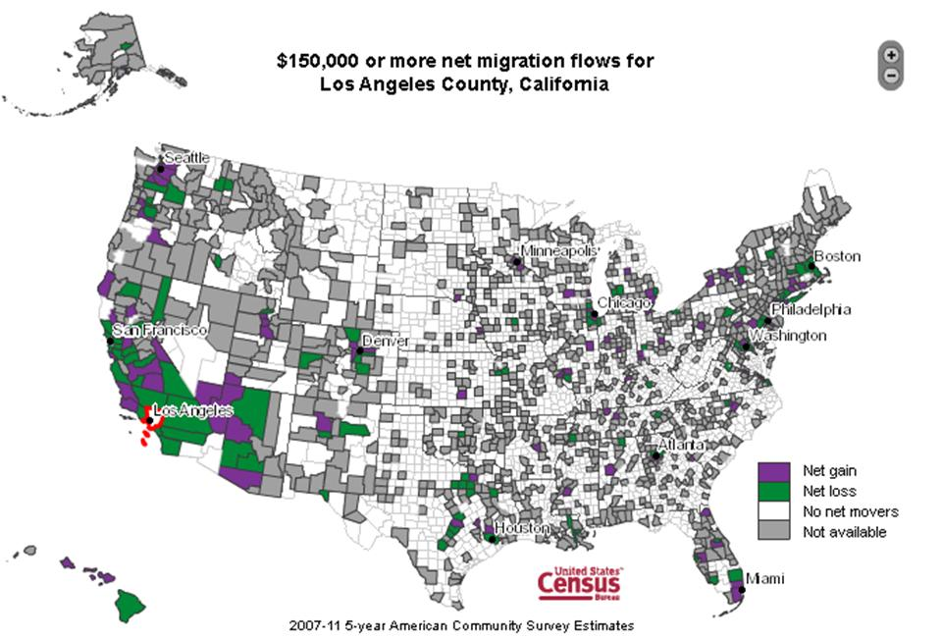

Slide 30
Among Largest Domestic Migration with Household Income of $150,000 or More (population 1 year and over living in housholds)
Inbound
Outbound
Los Angeles County, CA | 26,471
From: Orange County, CA | 4,652
San Bernardino County, CA | 1,501
Ventura County, CA | 1,349
San Diego County, CA | 1,276
Riverside County, CA | 1,067
Los Angeles County, CA | 34,336
To: Orange County, CA | 6,566
Riverside County, CA | 2,840
Ventura County, CA | 2,680
San Bernardino County, CA | 2,642
San Diego County, CA | 1,453
Over 26 thousand migrants into Los Angeles County, CA with a household income greater than or equal to $150,000, a little more than 17 percent were from Orange County, CA. When considering those leaving Los Angeles County, just over 19 percent with household incomes greater than $150,000 left for neighboring Orange County, CA . This suggests that Los Angeles County is losing more affluent households to surrounding communities.

Slide 31
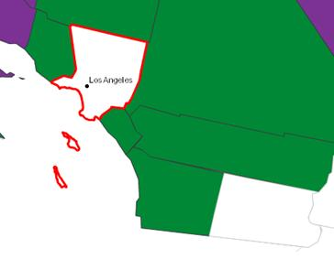
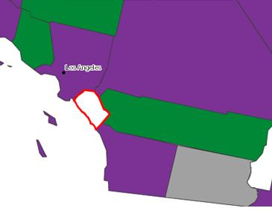
Household Income: $150,000 or more
Los Angeles County, CA
County | Net Migrants
Orange County, CA | -1,914
Riverside County, CA | -1,773
San Bernardino County, CA | -1,141
Kern County, CA | -104
Ventura County, CA | -1,331
Orange County, CA
County | Net Migrants
San Diego County, CA | 275
Riverside County, CA | -321
San Bernardino County, CA | 238
Los Angeles County, CA | 1,914
Ventura County, CA | -46

Slide 32
For more information contact:
Journey to Work and Migration Statistical Branch
(301) 763-2454 sehsd.migration@census.gov
Link to County-to-County Tables:
http://www.census.gov/hhes/migration/data/acs/county-to-county.html Link to Census Flows Mapper:
http://flowsmapper.geo.census.gov/flowsmapper/flowsmapper.html

